Slide 1
Design and manufacture of C.U.R.I.C.O:
an unmanned aerial-aquatic vehicle

Slide 2
What is it?

Slide 3
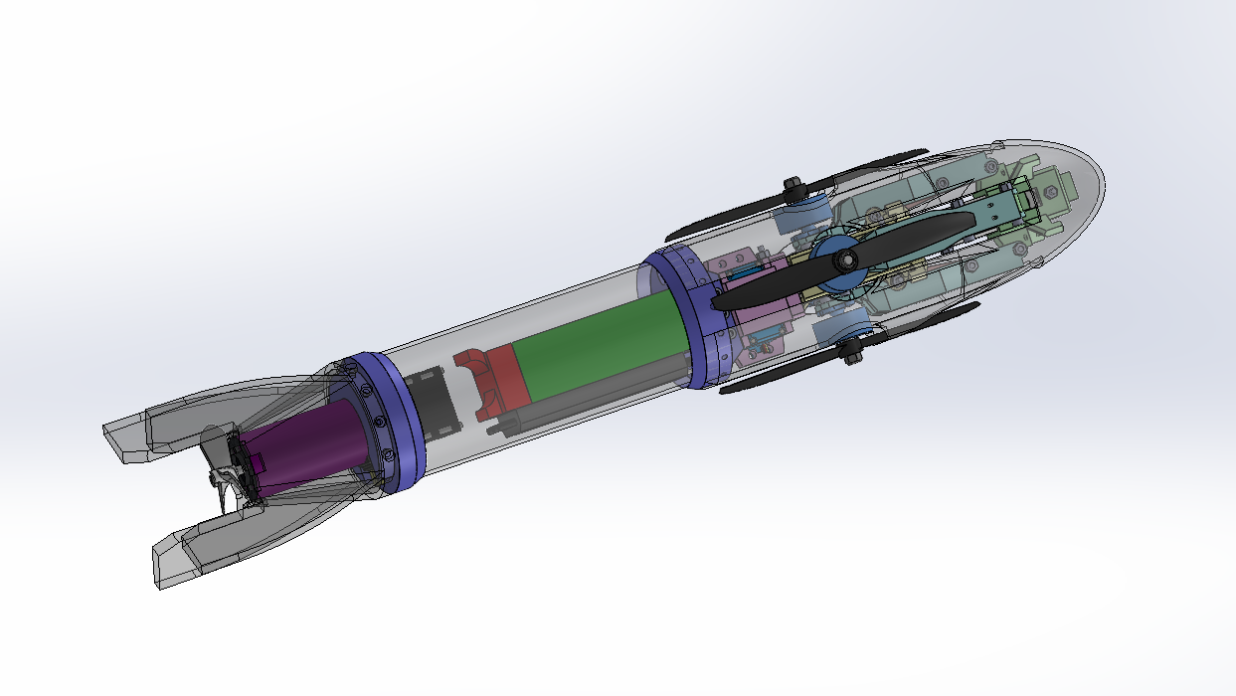

Slide 4
What will it do?

Slide 5
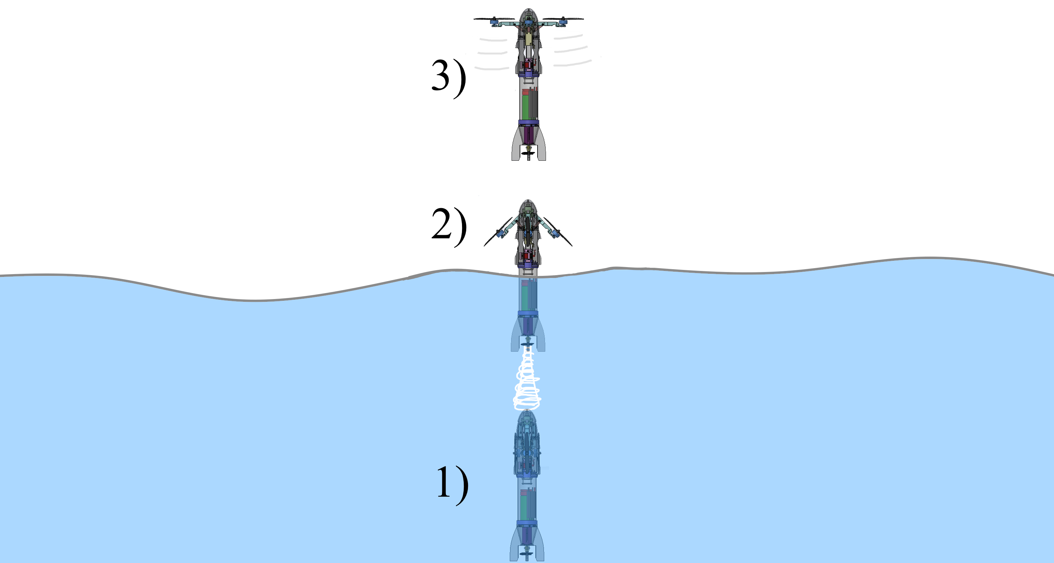
Aerial
Demonstrate the viability of this maneuver
Transition
Aquatic

Slide 6
Design

Slide 7
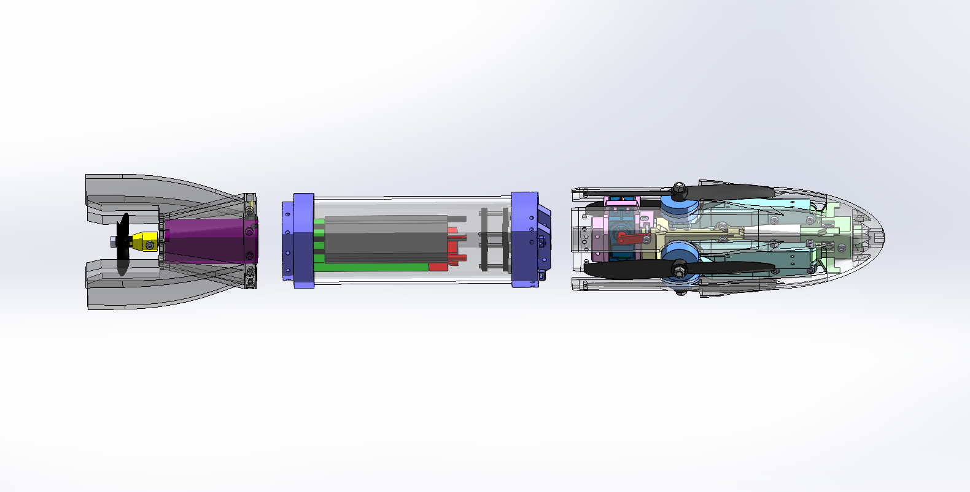
Aquatic Section
Aerial Section
Electronics

Slide 8
Aerial Section

Slide 9
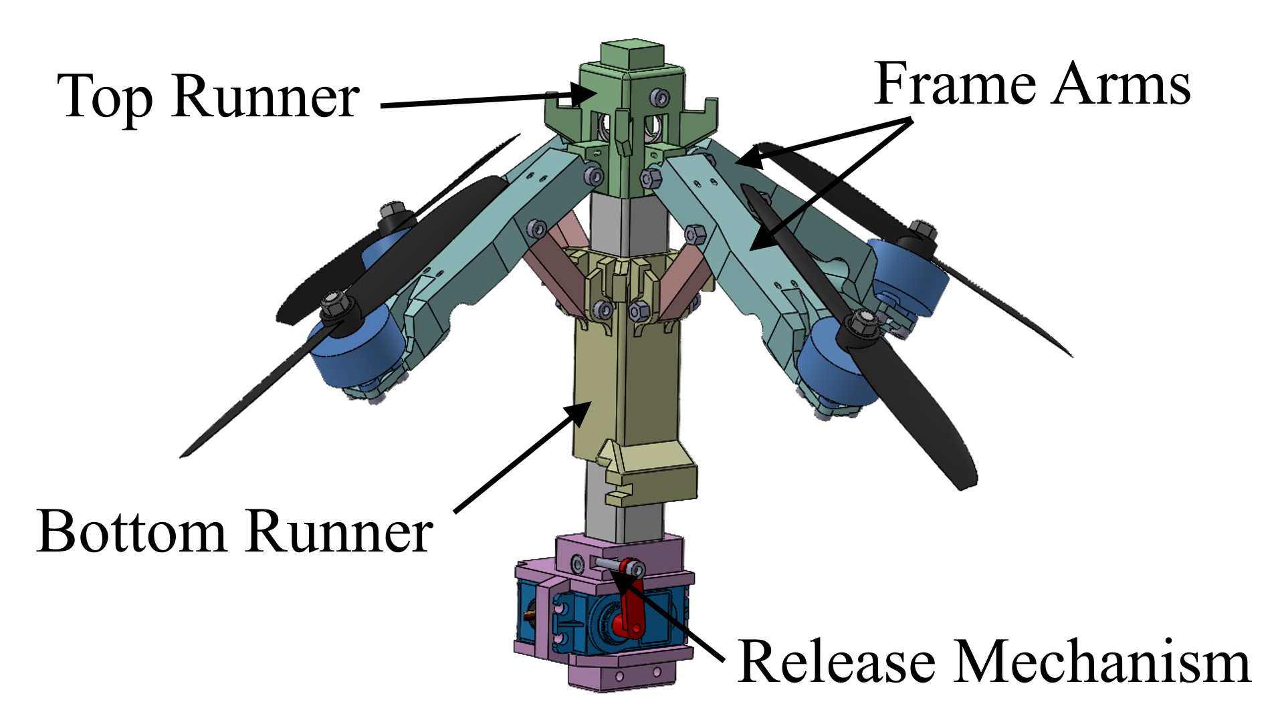

Slide 10
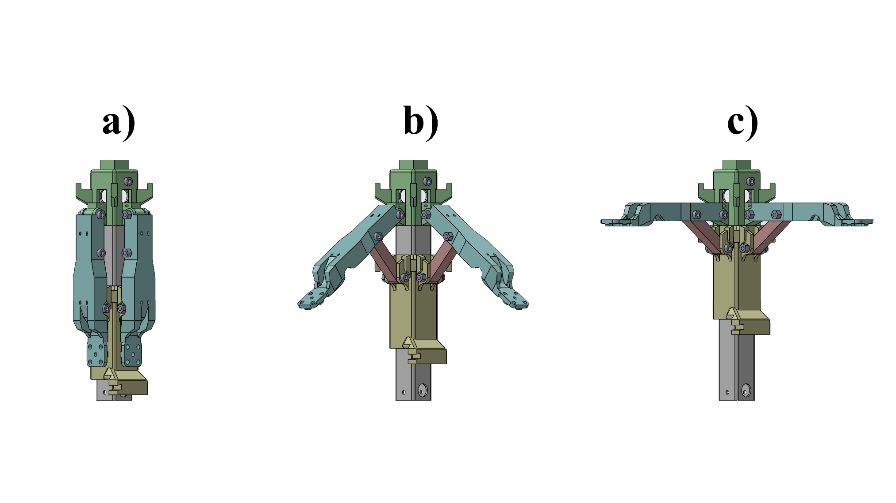
Aquatic
Transition
Aerial
Unfolding Mechanism

Slide 11
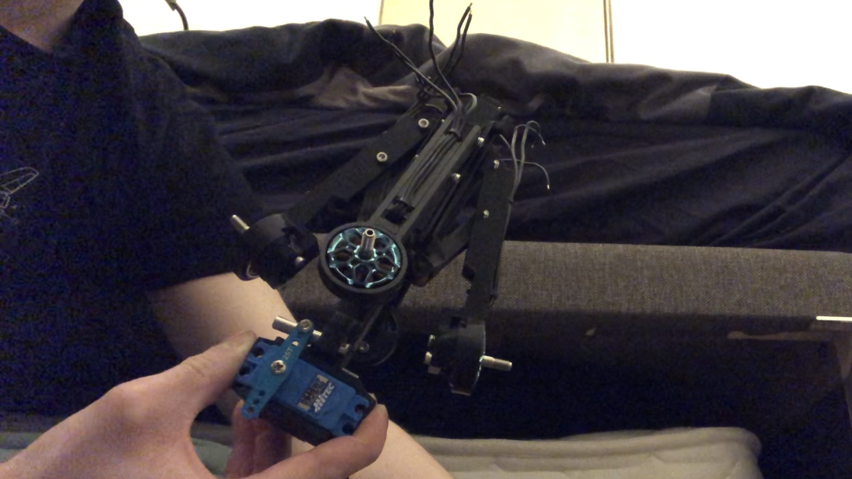

Slide 12
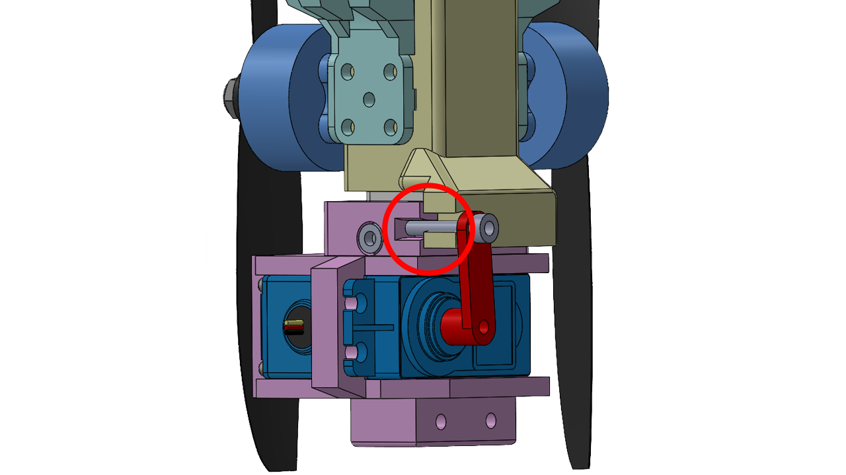

Slide 13
Aquatic Section

Slide 14
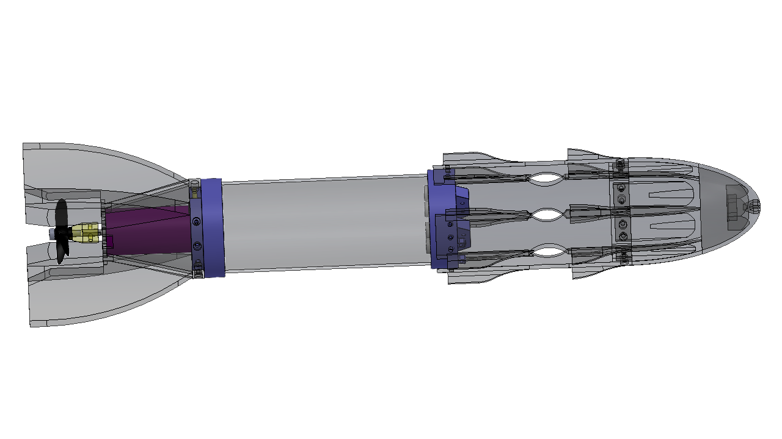
Tail Fins
Nose Cone
Waterproof
Electronics Compartment

Slide 15
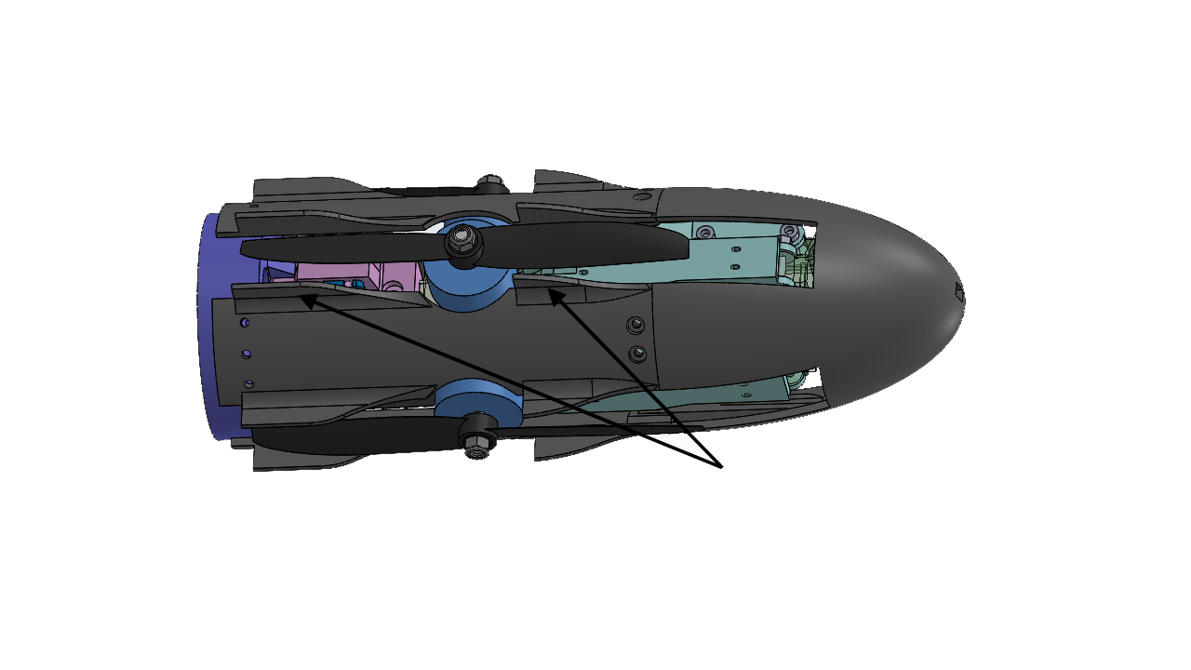
Fins block propeller motion

Slide 16
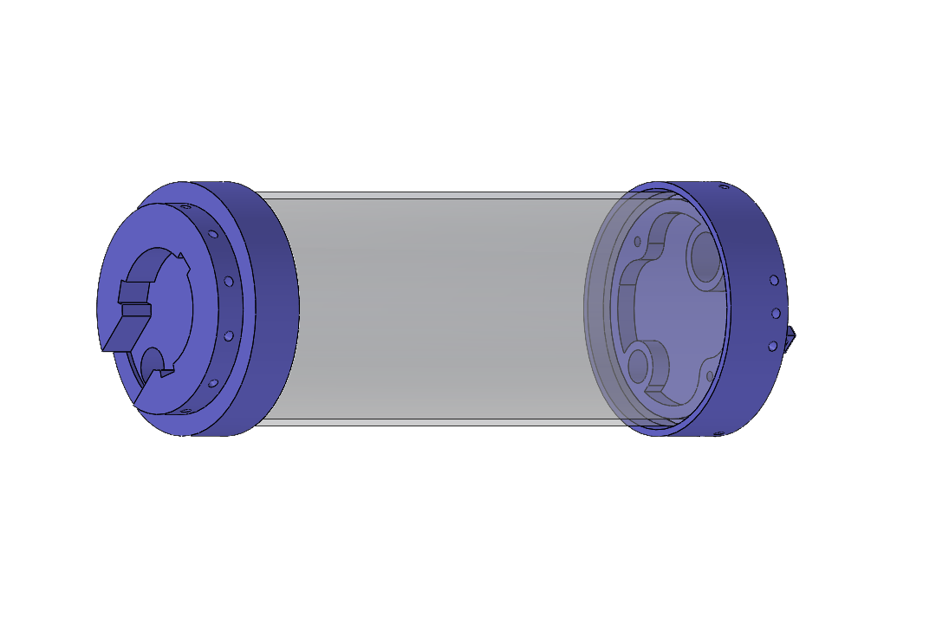
Bottom Seal
Top Seal
Acrylic Tube

Slide 17
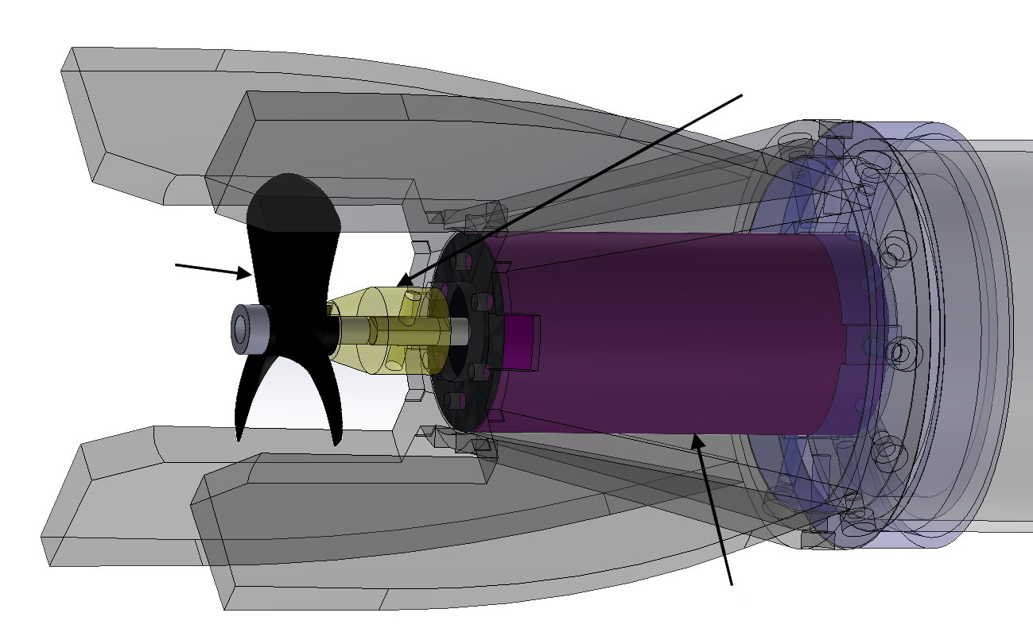
Shaft Coupler
Aquatic
Propeller
Aquatic Motor

Slide 18
Electronics

Slide 19
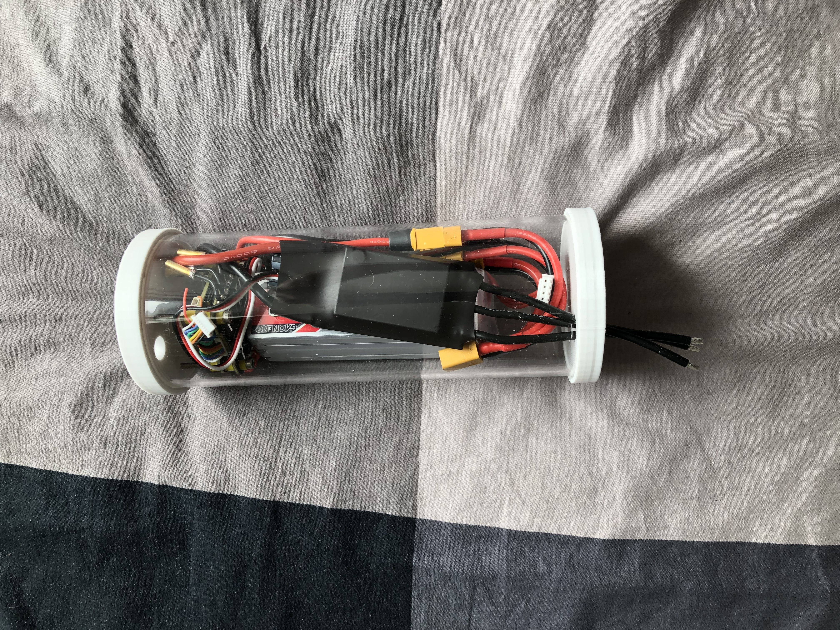

Slide 20
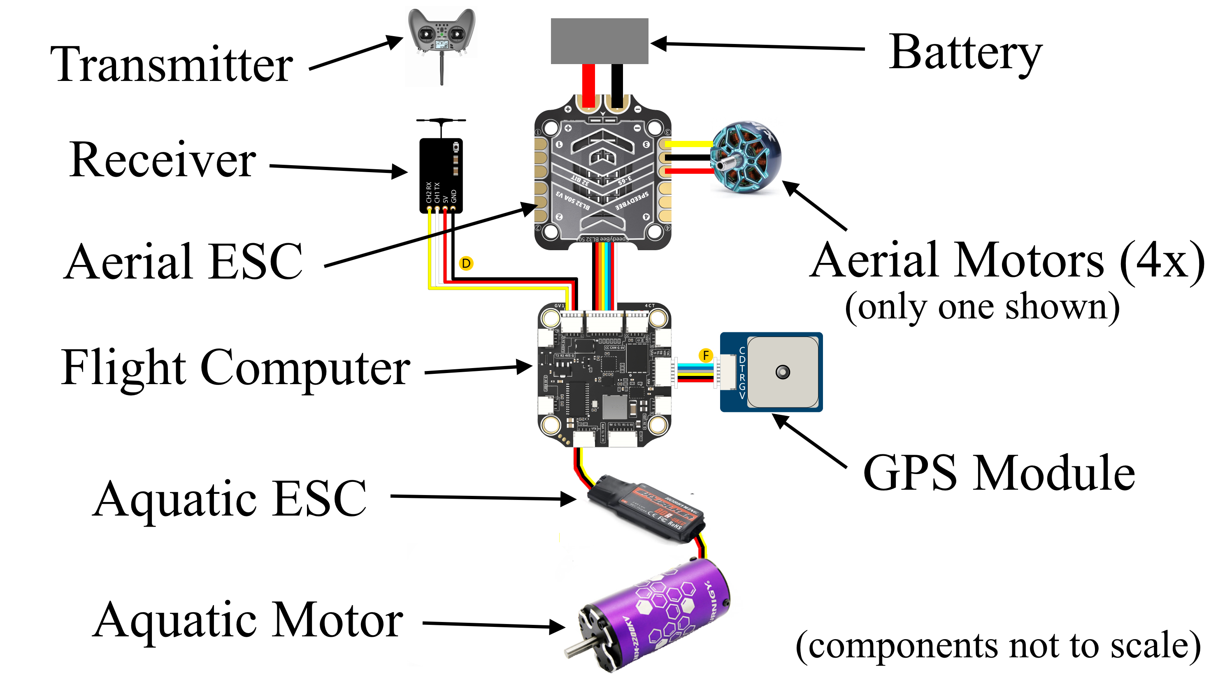

Slide 21
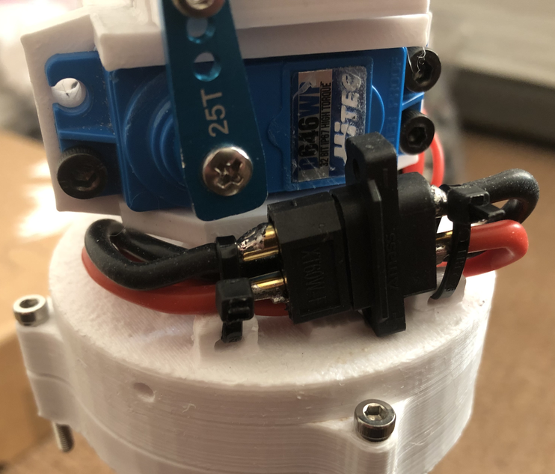

Slide 22
Manufacturing

Slide 23
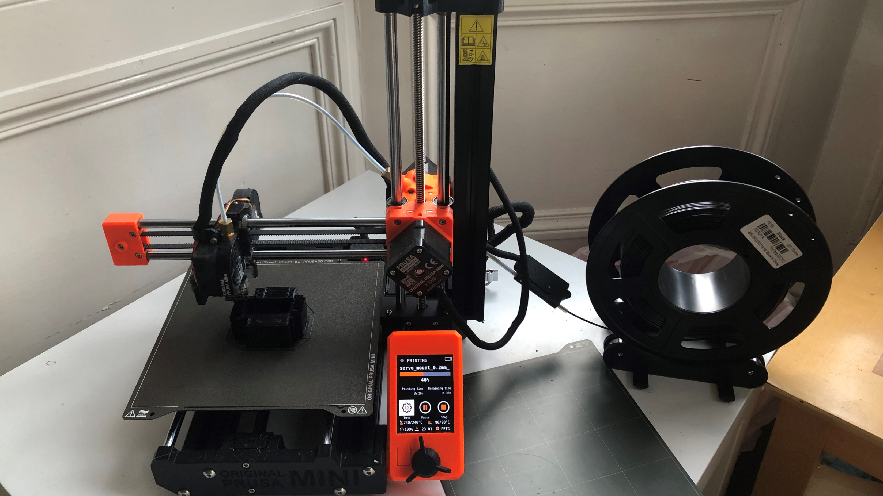

Slide 24
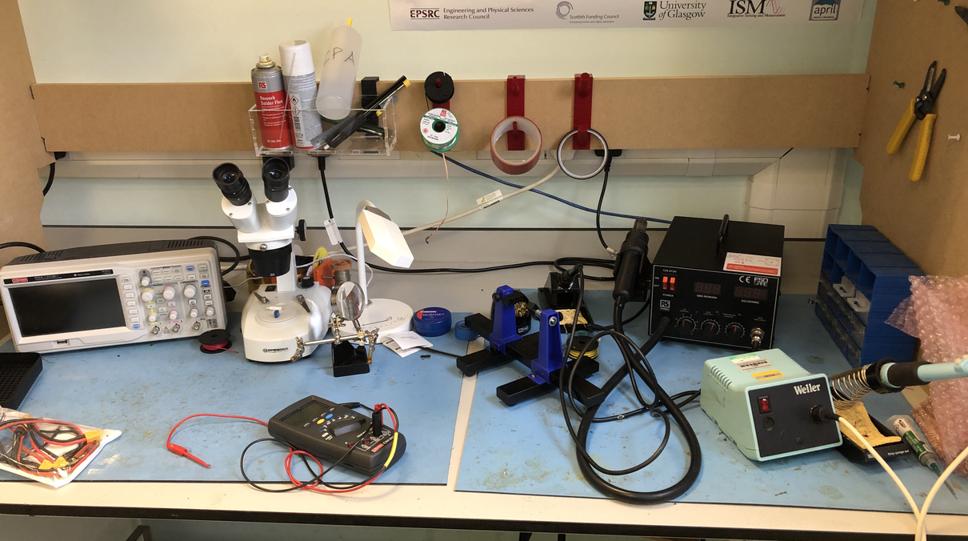

Slide 25
Final Assembly

Slide 26
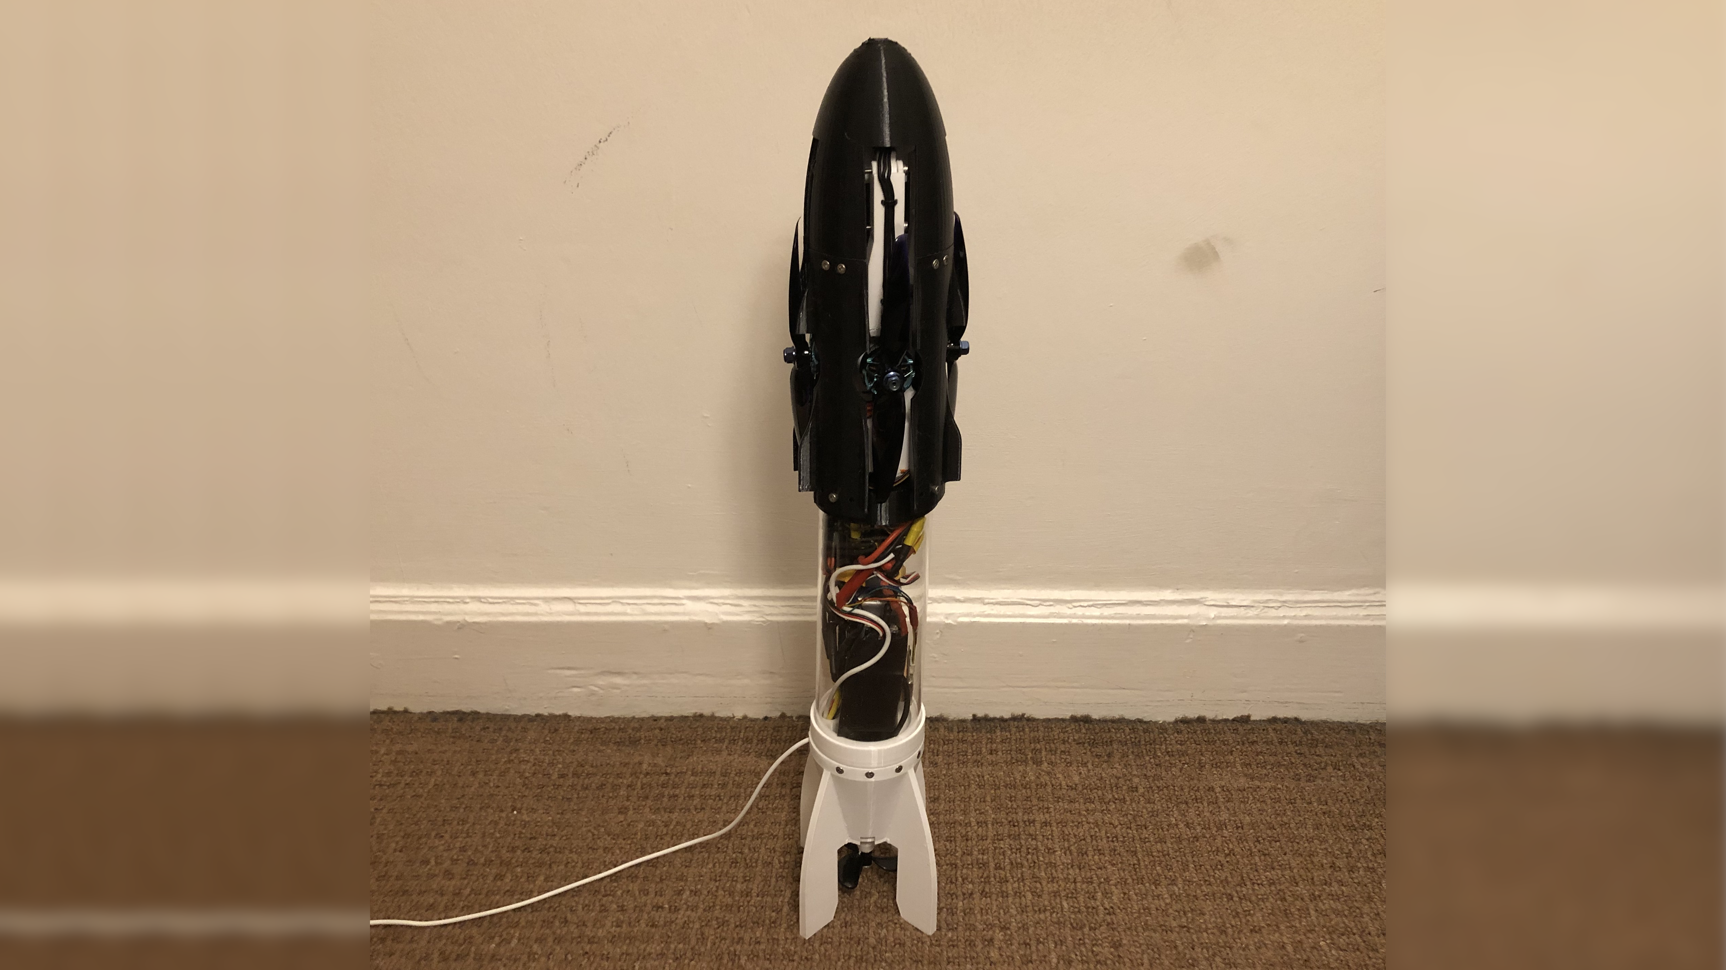

Slide 27
Experiments

Slide 28
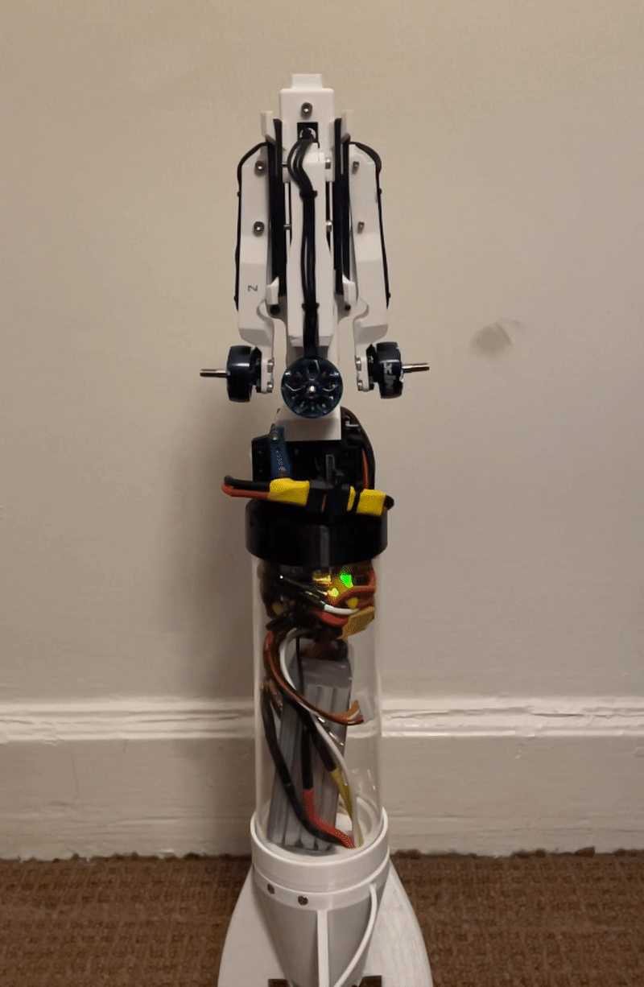

Slide 29
Key Results

Slide 30
- Complete manufactured TRL3 prototype ready for testing
- Mechanism fracture occurs at 15 rubber bands (45.6 N)
12 rubber bands: optimal for the maneuver due to having the fastest opening time (58 ms)

Slide 31
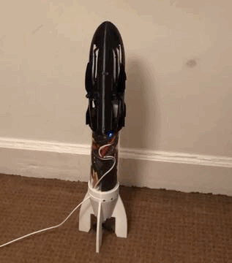
Thanks for listening!

